Slide 1
LT language
KALOLA KISHAN PRAVINBHAI
Roll no:IT37 ,ID: 17ITUOS128
KASUNDRA PRINCE KANTIBHAI
Roll no:IT38 ID:17ITUOS055

Slide 2
Language description/feature
Character set={A..Z,a..z,0..9,special char}
Datatype
={NUMBER,PNUMBER,BOOL,
VARCHAR}
Printing=KP.out()
Scan=Kp.in()
Our language is based this four language,our language check that the syntax is correct or not?
If it is correct then says that your syntax is correct otherwise says that unrecognised.

Slide 3

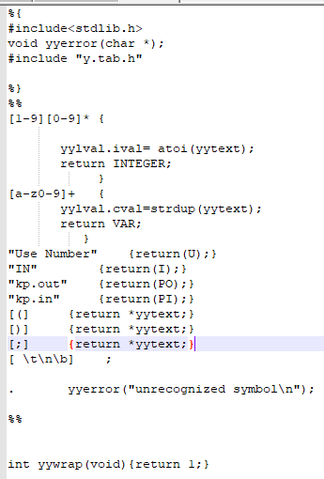
Mylang.l

Slide 4
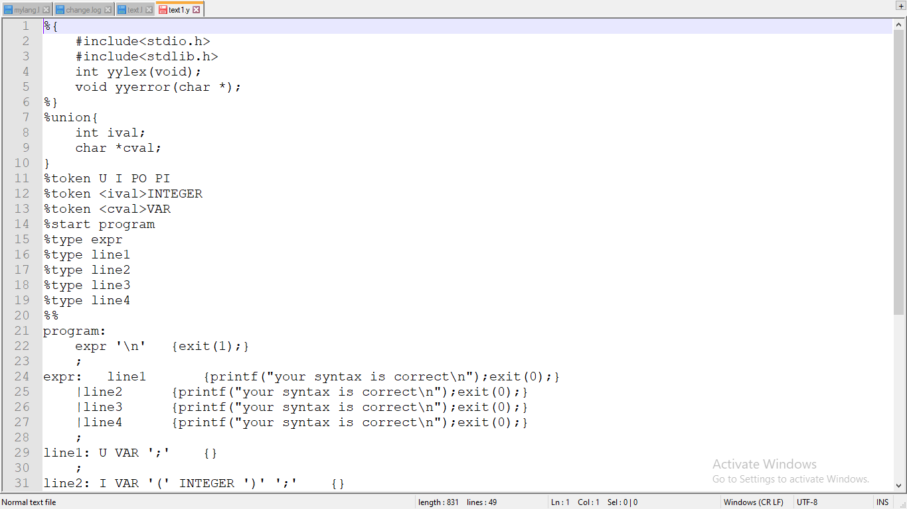
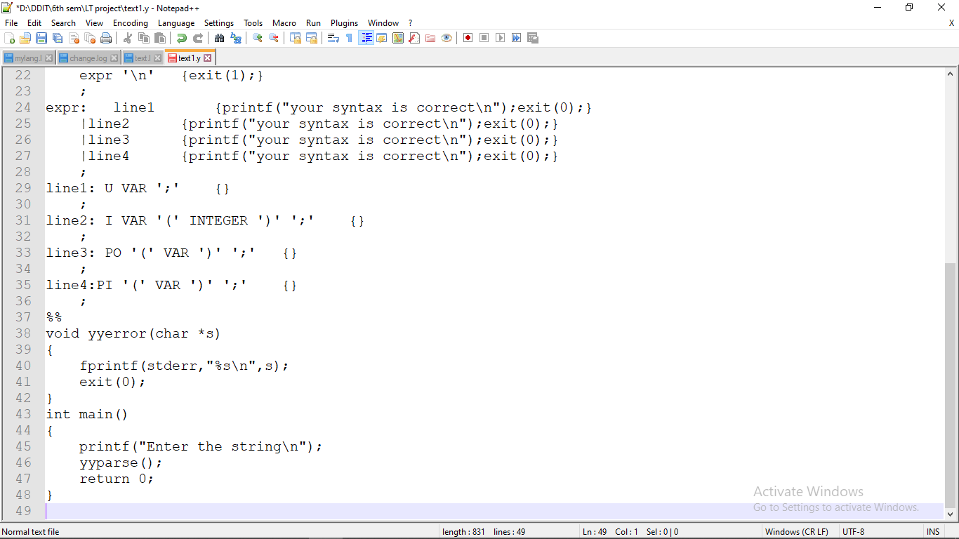
MyLang.y

Slide 5
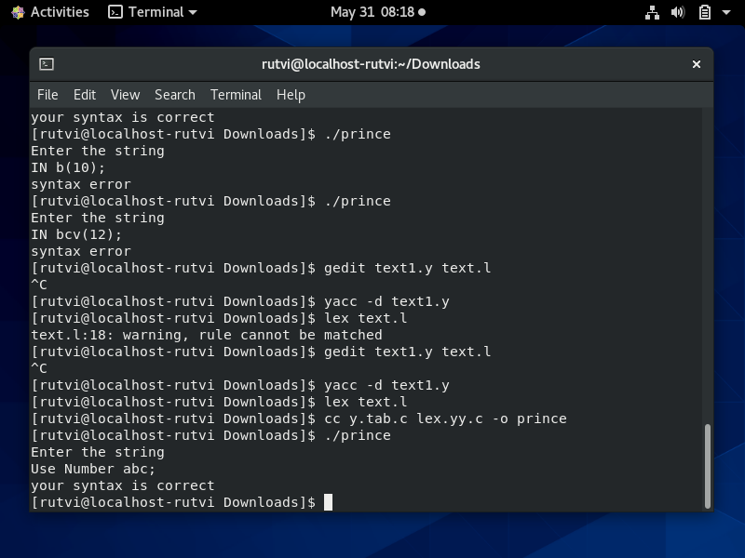
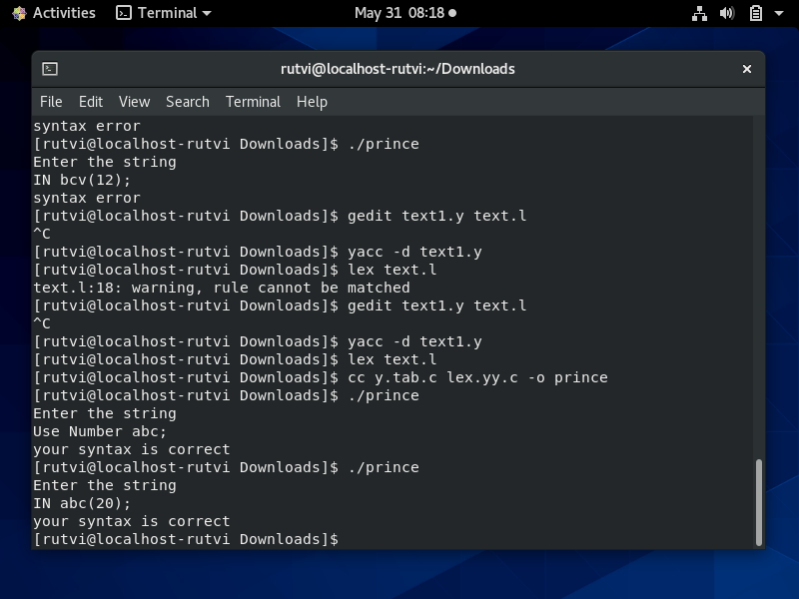
OUTPUT

Slide 6
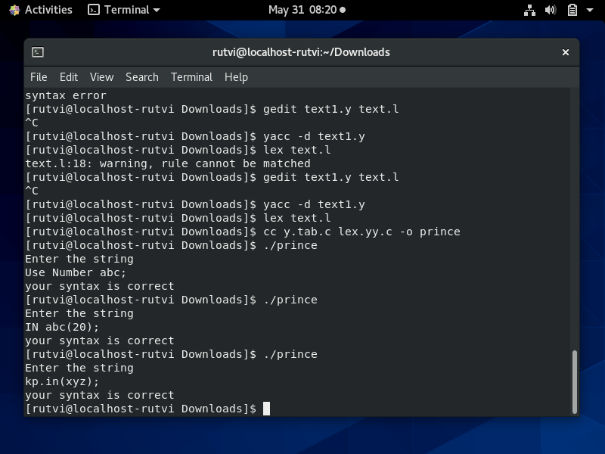
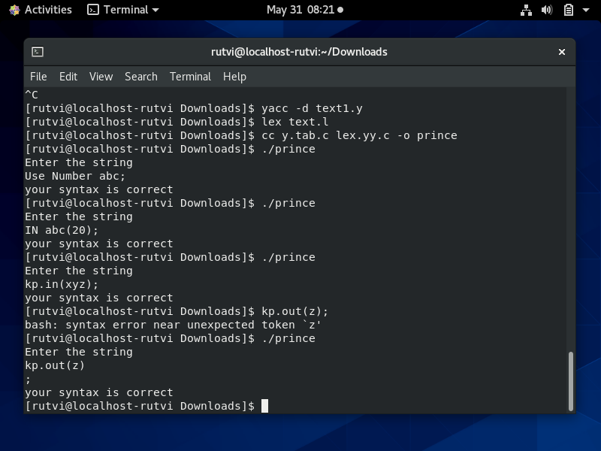
OUTPUT

Slide 7
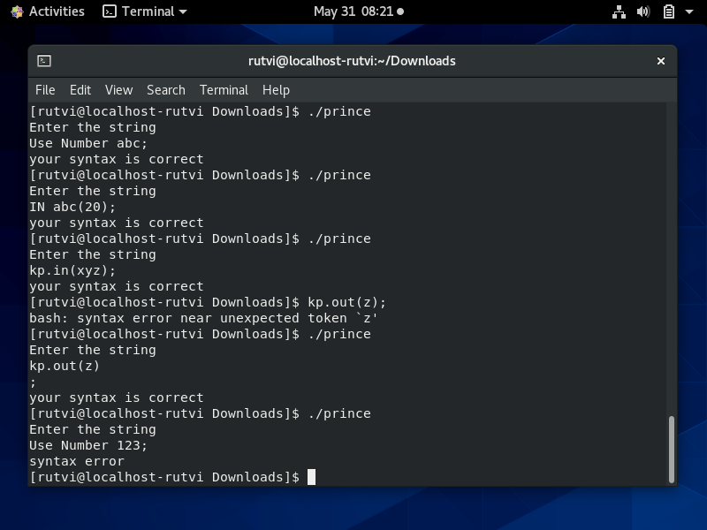
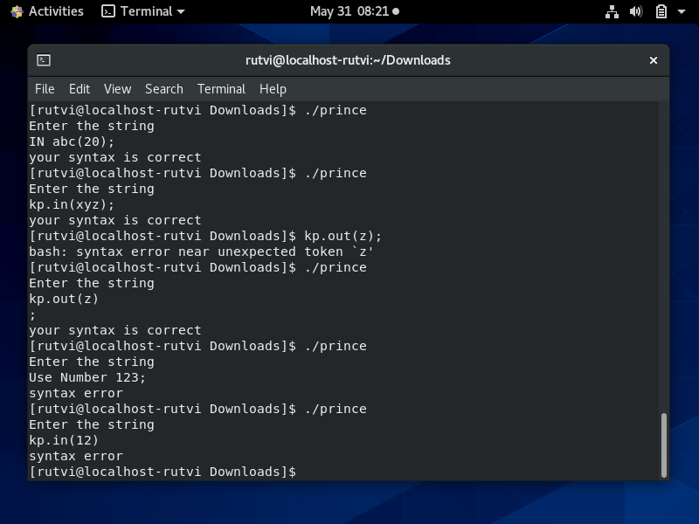
OUTPUT

Slide 8
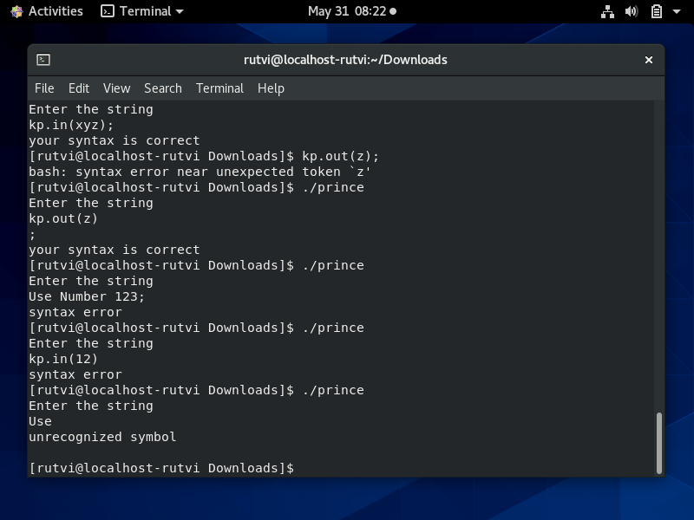
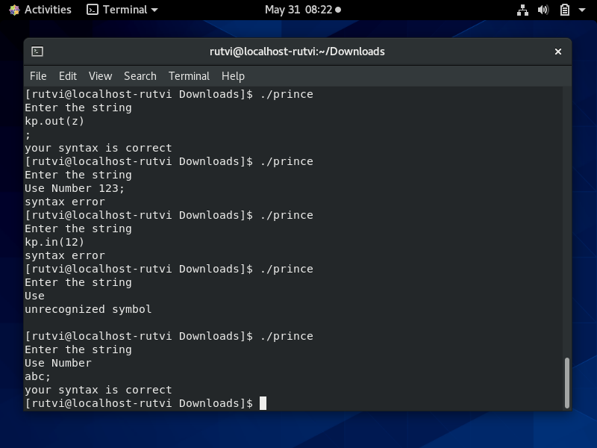
OUTPUT

